Slide 1
Family Relationship Centres
A key and (mainly) successful part of Australia’s family law system
Lawrie Moloney
Australian Institute of Family Studies
Notes:
Please add the title of the paper and author names in the File > Properties dialogue box.

Slide 2
Disclaimer
The views expressed in this paper and the accompanying text are those of the author and may not reflect the views of the Australian Institute of Family Studies or the Australian Government.

Slide 3
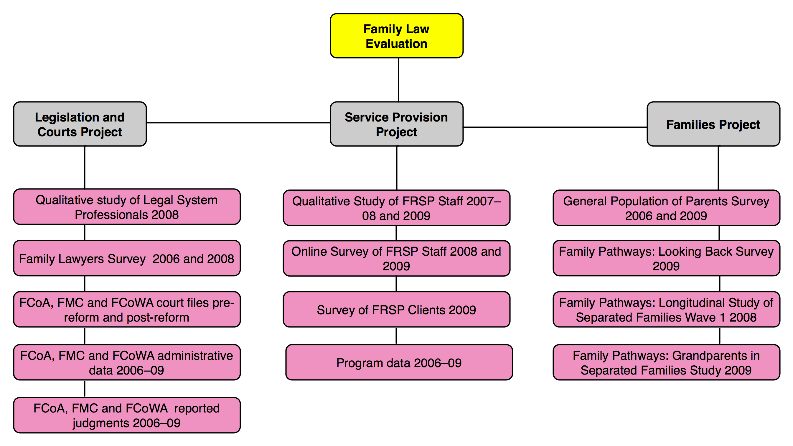
Primary Evaluation Strategy
(Six million dollars)
Notes:
Use this slide to create normal text slides. This is the default.

Slide 4
Scope of original evaluation
Information collected from over 28,000 respondents
2,005 parents who had separated prior to the 2006 reforms (LBS)
10,002 parents who had separated after the 2006 reforms (LSSF)
10,000 parents in a nationally representative survey of all parents - including separated parents (5,000 pre-reform and 5,000 post-reform)
562 grandparents who had an adult child who had separated
3,251 clients of services funded as part of the family law system
1,668 service providers (including managers and staff of relationship service providers)
367 family lawyers (surveyed pre-reform) and 319 lawyers (surveyed post-reform)
184 qualitative interviews with judicial officers, registrars, lawyers and family consultants
Information sampled from 1,724 court files from the FCoA, FMC and FCoWA
Notes:
Most of the data we will b looking at comes from the highlighted areas, We now three waves of data on the LSSF (Longitudinal Study of Separated Families) Wave 1 about 15 months after separation; Wave 2 a little over two years’ wave 3 about 4 years.

Slide 5
Perceived quality of inter-parental relationship by gender and wave

Slide 6
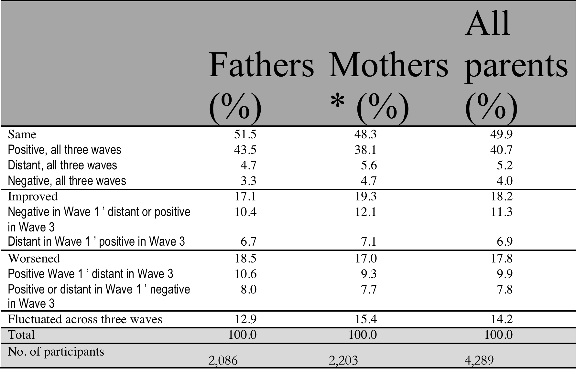
Changes in perceived quality of inter-parental relationship reported in Waves 1, 2 and 3, by gender

Slide 7
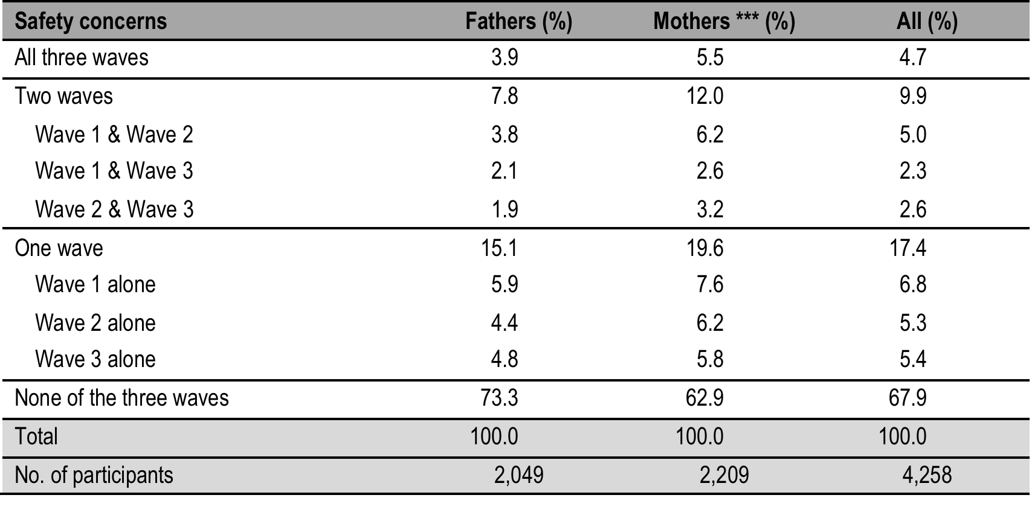
Reports of safety concerns for self and/or child, by gender, continuing sample

Slide 8
Behaviours/mental health state generating concerns among parents who held safety concerns, by gender, Wave 3
Behaviours/ Mental State | % Fathers | %Mothers | % All
Emotional Abuse or Anger Issues | 78 | 83 | 81
Mental Health Issues | 70 | 62 | 65
Violent or dangerous behaviour | 58 | 66 | 63
Alcohol or substance abuse | 49 | 55 | 52
Neglect or lack of supervision | 58 | 59 | 59
Road safety or other physical issues | 35 | 44 | 40

Slide 9
Quality of inter-parental relationship, by whether parent held safety concerns and gender, Wave 3

Slide 10
Quality of relationships – a critical factor
The evidence [from the three waves] suggested that most separated parents were relating to each other fairly well. Data on service use and main pathways towards sorting out arrangements for their children suggest that, at most, these parents needed only modest assistance from facilitative, therapeutic or advisory services (including services of a legal nature).

Slide 11
The idea of a Family Relationship Centre
FRCs were designed to act as highly visible entry points into the family law system, delivering services to families through the provision of:
information and referral services on parenting and relationships to intact families; and
information, referral, advice, and dispute resolution services to separating and separated families to help them reach agreement on parenting arrangements without the need to go to court.

Slide 12
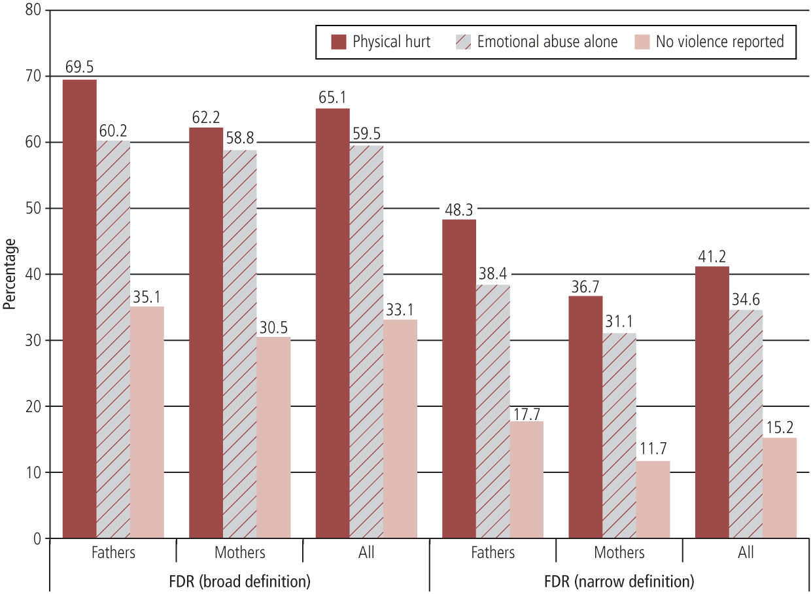
Fathers and mothers who contacted or used counselling, FDR or mediation, by experience of family violence, 2008
Source: LSSF W1 2008
Notes:
Figure 5.1 (p 100) of the evaluation report. Figure note: “Broad definition” includes those who went to a counsellor, psychologists, or mental health professional. “Narrow definition” refers to parents who attempted FDR.
When did you last have a straightforward case?

Slide 13
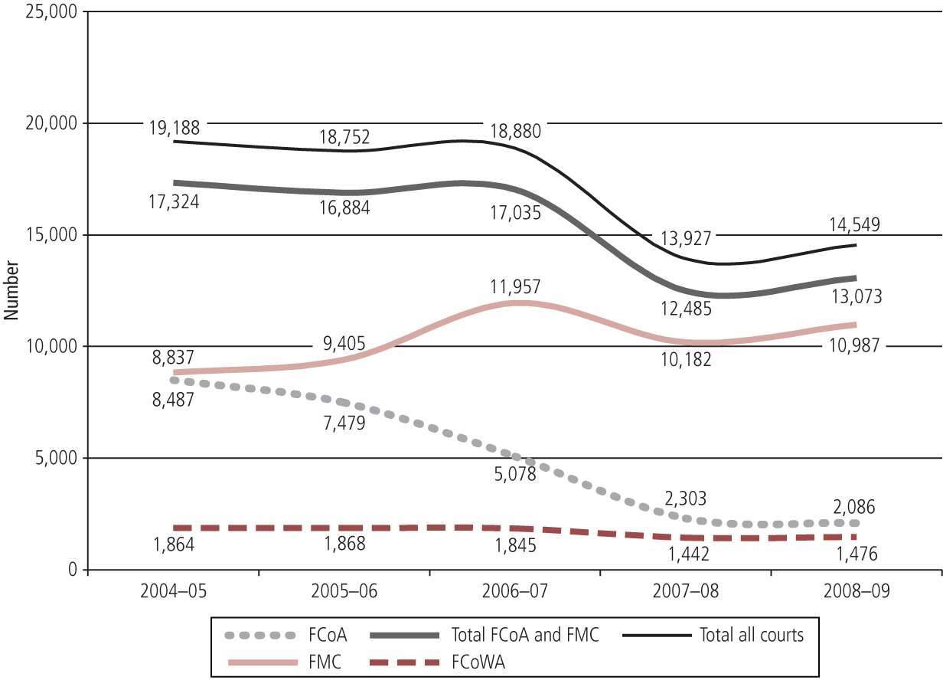
Initial impact on litigation
Number of applications for final orders (children, children+property),
by court, 2004-5 to 2008-09
Source: FCoA, FMC and FCoWA administrative data 2004-09
Notes:
Notes for Alan: This graph sourced from Figure 13.1, p 305 of the evaluation report. Includes children only, and children plus property matters. This represents a 22 per cent decrease in overall filings in children’s matters in the three year evaluation period. These are early data and there was concern that the figures might reflect some sort of ‘Hawthorn Effect’ But Parkinson’s analysis in 20XX and more recent court files data suggest that these figures have been sustained over time.

Slide 14
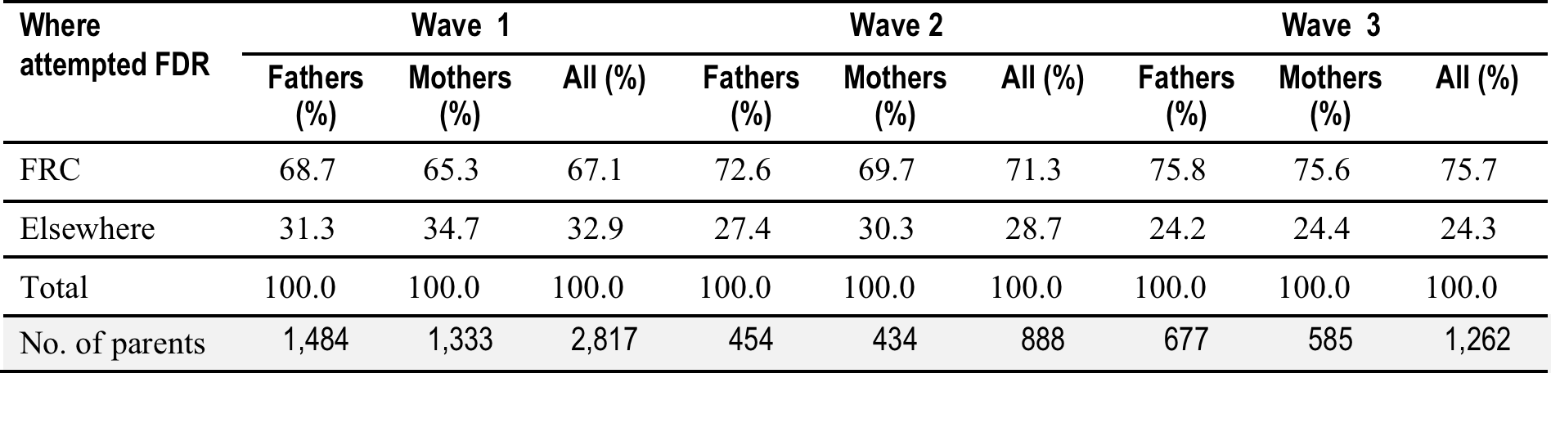
Where did parents report attempting FDR
By gender and wave
Notes:
Table 4.18 summarises the data regarding location of FDR use at each wave. The table shows that FRCs were used significantly more often than other services for FDR and that the conduct of FDR at FRCs in each wave increased over time (67% in Wave 1; 71% in Wave 2; and 76% in Wave 3).

Slide 15
Initial impact on litigation
Number of applications for final orders (children, children+property),
by court, 2004-5 to 2008-09
Source: FCoA, FMC and FCoWA administrative data 2004-09
Notes:
Notes for Alan: This graph sourced from Figure 13.1, p 305 of the evaluation report. Includes children only, and children plus property matters. This represents a 22 per cent decrease in overall filings in children’s matters in the three year evaluation period. These are early data and there was concern that the figures might reflect some sort of ‘Hawthorn Effect’ But Parkinson’s analysis in 20XX and more recent court files data suggest that these figures have been sustained over time.

Slide 16
Sustained impact on litigation
Applications reduced:
Between 2004-5 and 2008-9 by 22% (Kaspiew et al 2009).
Between 2004-5 and 2011-12 by 32% (Parkinson 2013).
Between 2004-5 and 1013-14 by 25% (Kaspiew, Moloney & Dunstan & De Maio 2015)
Notes:
Overall decrease in contested cases – 14%. Main reason is introduction of hearing of property cases in defacto marriages. Parkinson looked at data from annual reports of Family Courts. Fair to say that the Kaspiew et al study was methodologically more rigorous.

Slide 17
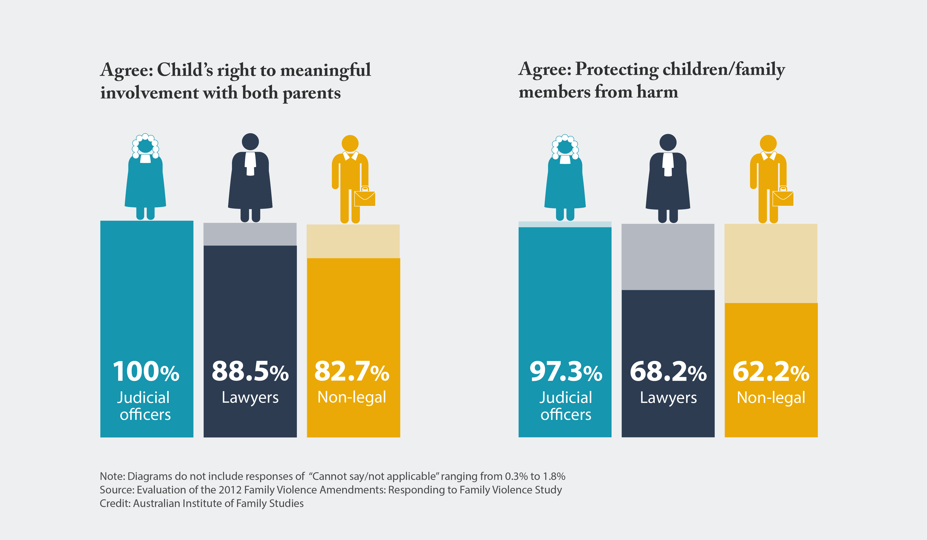
Adequate priority: meaningful relationship and protection from harm

Slide 18
Two complementary innovations
Family law pathways initiative (2001)
Support for development of and training in child sensitive practices – child focused and child inclusive mediation

Slide 19
Future Innovations?
Mediators as reporters?
Attending to the mechanisms of intra disciplinary and interdisciplinary cooperation
“It takes a village”
Expanding the FRC concept

Slide 20
Cooperation: an example
Mr R, what you have done to your wife is a criminal act under the laws of this state, regardless of what you say she did or said to provoke you, and there are consequences that the Court is bound to impose. What you did is also very harmful to your children, whether they actually witnessed the event or not. Living in a violent home is bad for children. Mr R, I hear you when you say that you love your wife and children, that you are sorry for what you did and that you have promised not to do that again. The Court is going to help you keep that promise by doing three things: first, by providing your family with protection until it can be sure that you are no longer a danger, and that you can show you are no longer a danger; secondly by providing you an opportunity to manage your anger better and to resolve conflict in a non-violent way; and third, by providing you and your children a safe place to visit together, where they will not be afraid, and you will be given an opportunity to show that you have a loving relationship with your son and daughter. (Johnston, Roseby & Kuehnle 2009, p. 27).

Slide 21
Thank You

Slide 22
References
Auditor General (2011) Audit Report No.1 2010–11. Performance Audit. Implementation of the Family Relationship Centres Initiative. Canberra: Attorney-General’s Department. Department of Families, Housing, Community Services and Indigenous Affairs.
Australian Government. (2005). A new family law system: Government response to Every Picture Tells a Story: Implementation plan for package of reforms (Confidential paper). Canberra: Australian Government.
Finlay, H. (2005). To have but no to hold: A history of attitudes to marriage and divorce in Australia. 1858 - 1975 Leichhardt, NSW: Federation Press.
Fogarty, J. (2006) Thirty years of change. Australian Family Lawyer 18(4) 15-24.
House of Representatives Standing Committee on Family and Community Affairs (2003). Every picture tells a story: Report on the inquiry into child custody arrangements in the event of family separation. Canberra: Commonwealth of Australia.
Johnston, J., Roseby, V., & Kuehnle, K. (2009). In the name of the child: A developmental approach to understanding and helping children of conflicted and violent divorce. New York: Springer Publishing.
Kaspiew, R., Gray, M., Weston, R., Moloney, L., Hand, K., Qu, L., & the Family Law Evaluation Team. (2009). Evaluation of the 2006 family law reforms. Melbourne: Australian Institute of Family Studies. Retrieved from <www.aifs.gov.au/institute/pubs/fle>.

Slide 23
References (cont)
Kaspiew, R., Moloney, L., Dunstan, J. & De Maio, J. (2015) Family law court filings 2004-05 to 2012-13 Research Report No. 30 — February 2015. Melbourne, Australian Institute of Family Studies.
Moloney, L. (2013) From “helping court” to community-bases services. The evolution of Australia’s Family Relationship Centres . Family Court Review 51 (2) 214-223.
Moloney, L. & McIntosh, J (2006) Child focused dialogues. Theoretical and clinical underpinnings of child focused dispute resolution. DVD companion handbook. Canberra: Attorney General’s Department
Moloney, L., Qu, L., Weston, R. & Hand, K. (2013) Evaluating the work of Australia’s Family Relationship Centres. Evidence from the first five years. Family Court Review 51 (2) 234-249.
Moloney, L. Kaspiew, R., De Maio, J & Deblaquiere, J. (2013) Family Relationship Centres; partnerships with legal assistance services. Family Court Review 51 (2) 250-257.

Slide 24
References (cont)
Moloney, L. (2014). Lionel Murphy and the dignified divorce. Of dreams and data. In A Hayes and D. Higgins. Contemporary issues in family law. Melbourne: Australian Institute of Family Studies 245-257.
Moloney, L., Smyth, B., Weston, R., Richardson, N., Qu, L., & Gray, M. (2007). Allegations of family violence and child abuse in family law children’s proceedings: A pre-reform exploratory study. Melbourne: Australian Institute of Family Studies.
Neff, R., & Cooper, K. (2004). Parental conflict resolution: Six-, twelve-, and fifteen-month follow-ups of a high-conflict program. Family Court Review, 42(1), 99–114.
Parkinson, P. (2013) The idea of Family Relationships Centres in Australia. Family Court Review 51 (2) 195-213.
Qu, L., & Weston, R. (2010). Parenting dynamics after separation: A follow-up study of parents who separated after the 2006 family law reforms. Melbourne: Australian Institute of Family Studies. Retrieved from <tinyurl.com/bwwdrqq>.
Qu, L., Weston, R., Moloney, L., Kaspiew, R., & Dunstan, J. (2014). Post-separation parenting, property and relationship dynamics after five years. Canberra: Attorney-General’s Department.

Slide 25
References (cont)
Swain, S. (2012) Born in hope. The early years of the Family Court of Australia. Sydney: NewSouth Publishing

